Slide 1
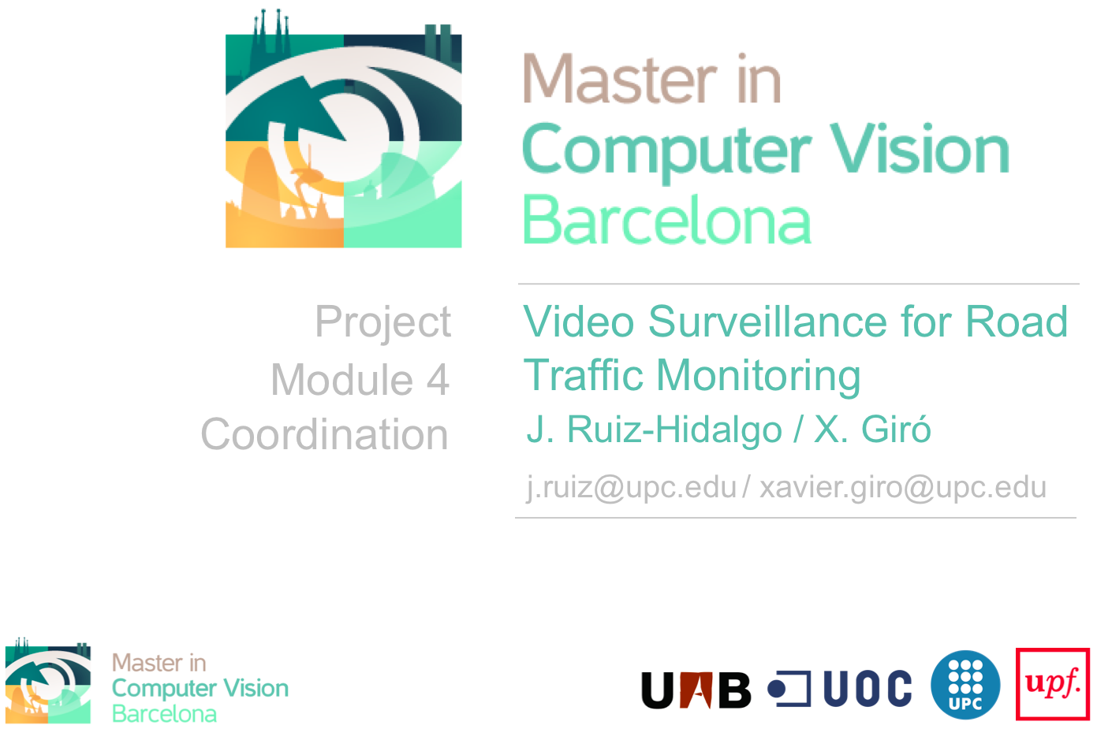
Project
Module 6
Coordination
Cristian Gutiérrez, Iñaki Lacunza, Carlos Boned, Marco Cordón
Week 4: Final Report
GROUP 6

Slide 2
Index
Task 1.1
Task 1.2
Task 2
Final Summary

Slide 3

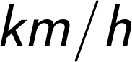
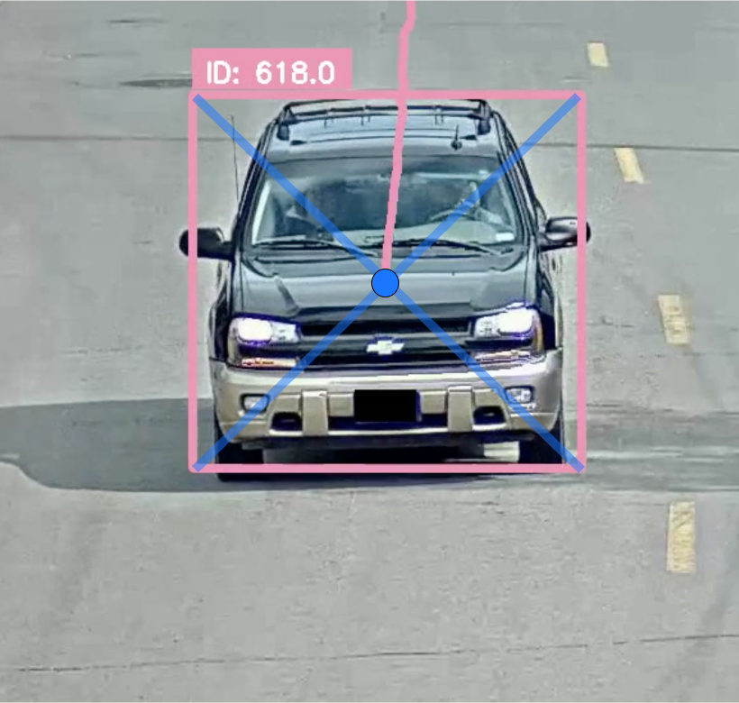
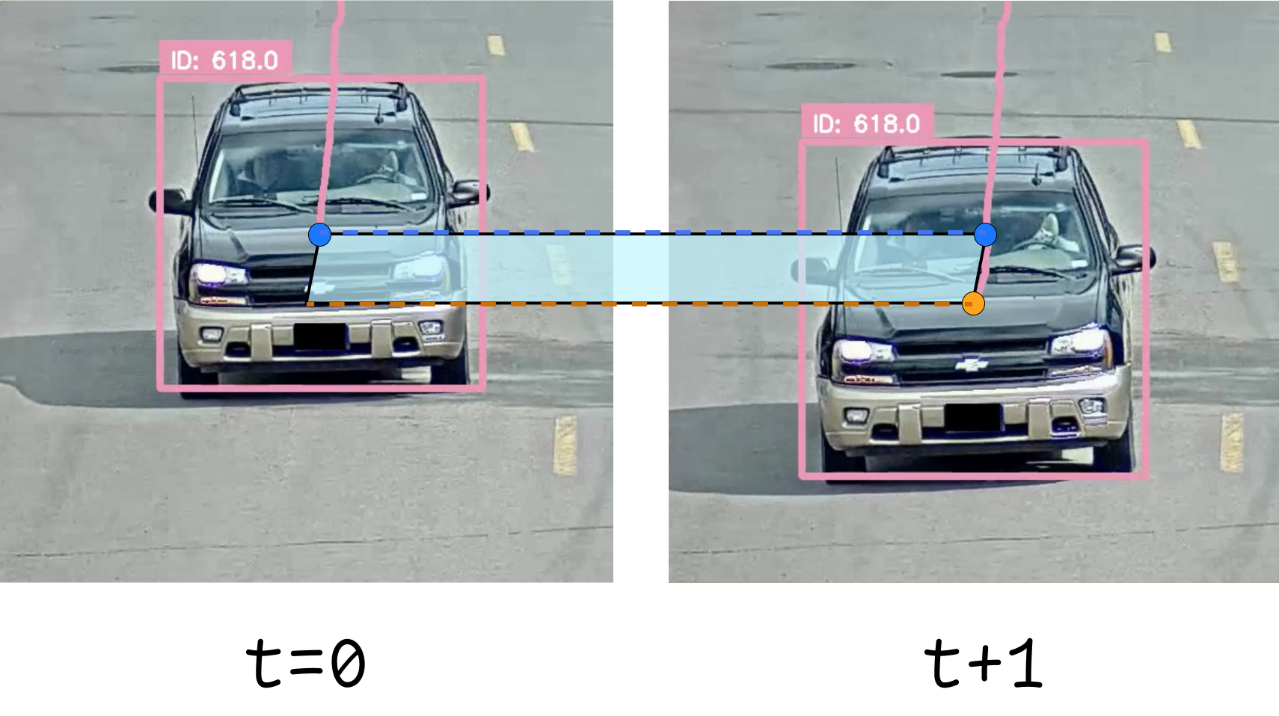
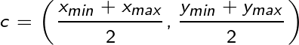
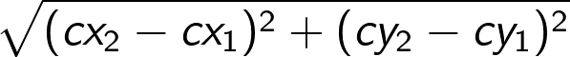
Task 1.1: Speed Estimation
10 FPS
CRISTIAN GUTIÉRREZ
1532397
#1 Centroid
#2 Displacement

Slide 4
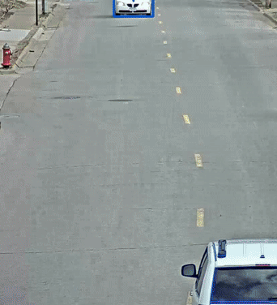
Task 1.1: Speed Estimation
Assumption #1: Fixed meters/pixel
CRISTIAN GUTIÉRREZ
1532397
~10 km/h
PROBLEM!
For a car in a constant~ velocity, as it approaches the camera it increases the velocity.
This is due to the perspective of
the camera!
~50 km/h

Slide 5
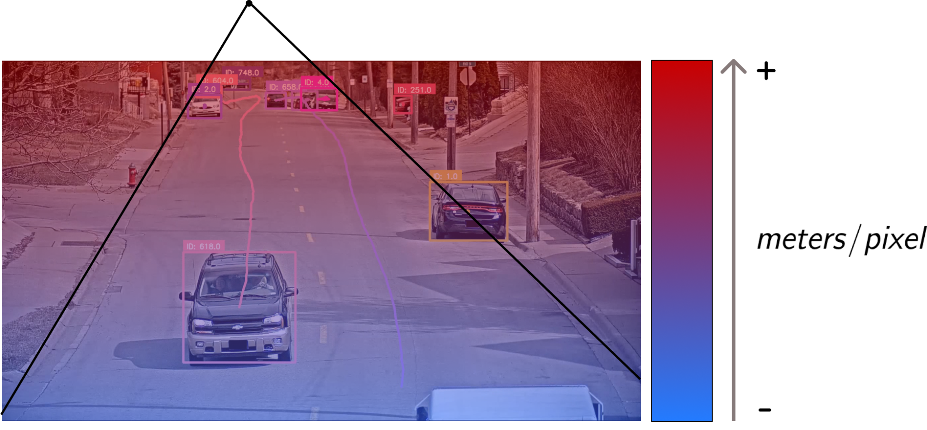
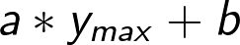
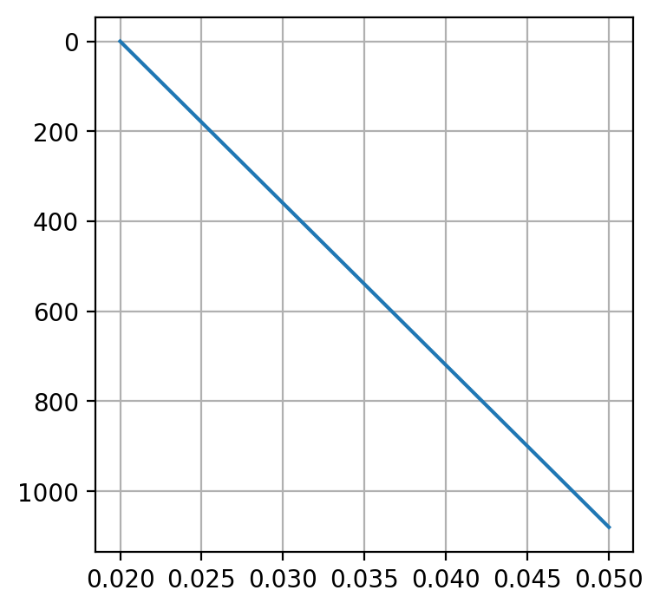
Task 1.1: Speed Estimation
Assumption #2: Linear meters/pixel
CRISTIAN GUTIÉRREZ
1532397
LINEAR FUNCTION

Slide 6
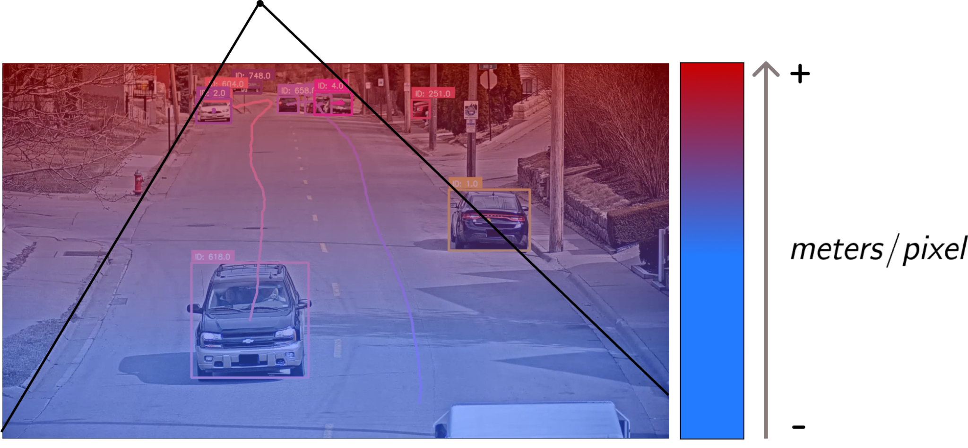
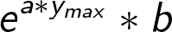
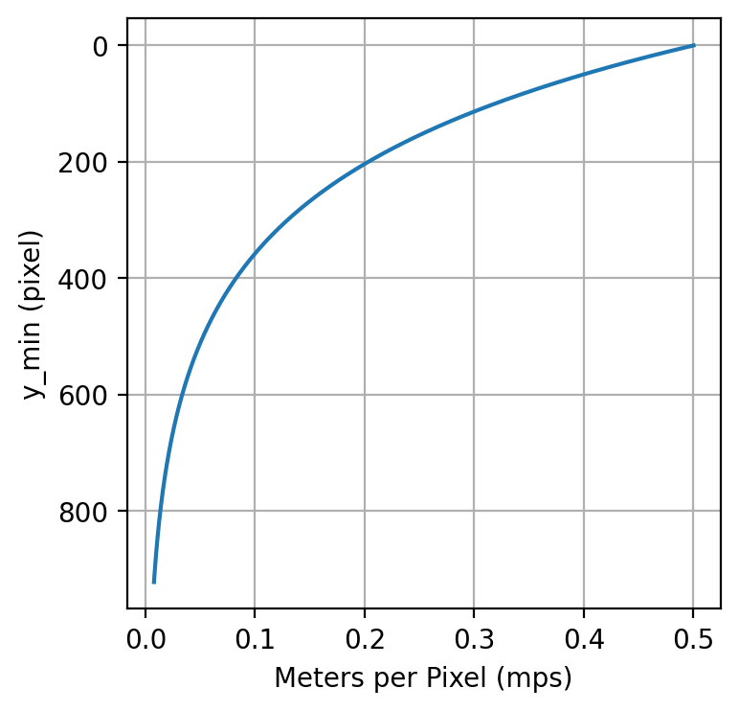
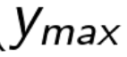
Task 1.1: Speed Estimation
Assumption #3: Exponential meters/pixel
CRISTIAN GUTIÉRREZ
1532397
EXPO FUNCTION

Slide 7
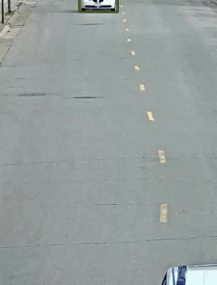
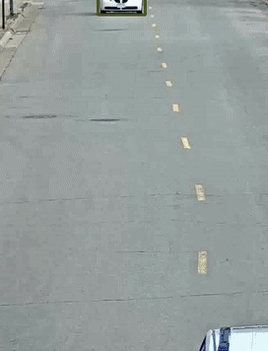

Task 1.1: Speed Estimation
Results
CRISTIAN GUTIÉRREZ
1532397
FIXED MPS=0.05
~10 km/h
~5 km/h
~30 km/h
~50 km/h
~25 km/h
~25 km/h

Slide 8
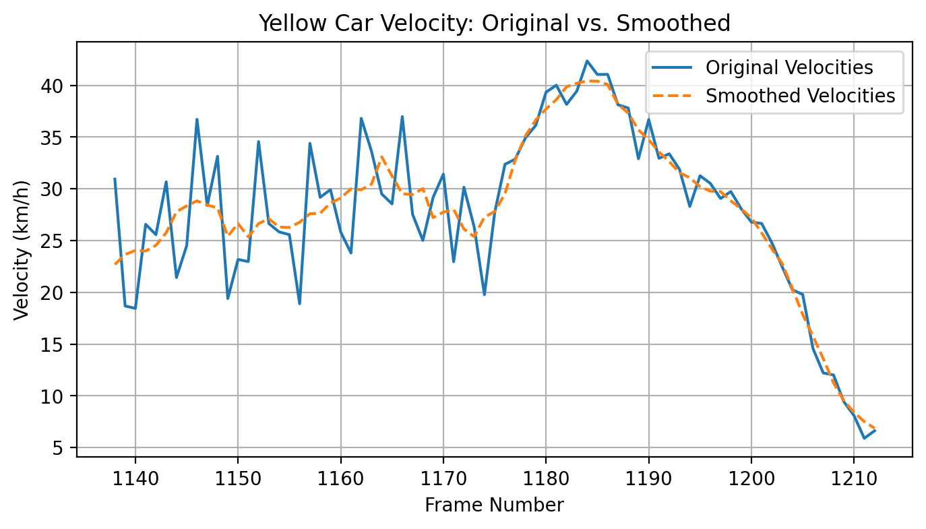
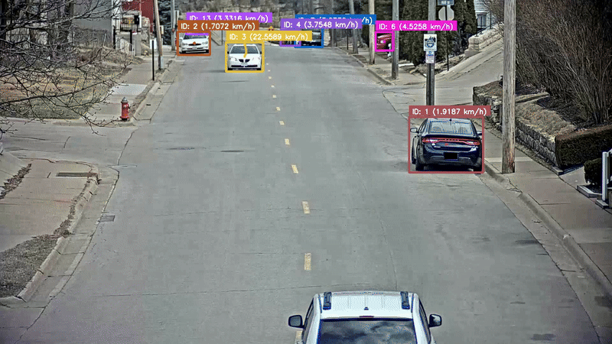
Task 1.1: Temporal Smoothing
CRISTIAN GUTIÉRREZ
1532397
We “self-calibrated” our sequence camera
WINDOW = 5

Slide 9

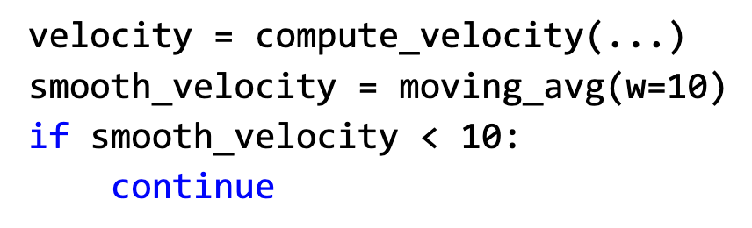
Task 1.1: Remove Parked Cars
CRISTIAN GUTIÉRREZ
1532397
 | Avg speed (km/h)
Vehicle 1 | 41.86
Vehicle 2 | 52.39
Vehicle 3 | 30.75
Vehicle 4 | 33.74
Vehicle 5 | 20.67
Vehicle 6 | 29.07
Vehicle 7 | 48.48
 | Avg speed (km/h)
Vehicle 8 | 42.36
Vehicle 9 | 30.91
Vehicle 10 | 38.66
Vehicle 11 | 24.72
Vehicle 12 | 37.32
Vehicle 13 | 36.37
Vehicle 14 | 38.07
To remove parked cars
WINDOW = 10
THRESHOLD = 10
FURTHER WORK:
CALIBRATE ALSO FOR X-AXIS AND FOR FURTHER AWAY CARS

Slide 10
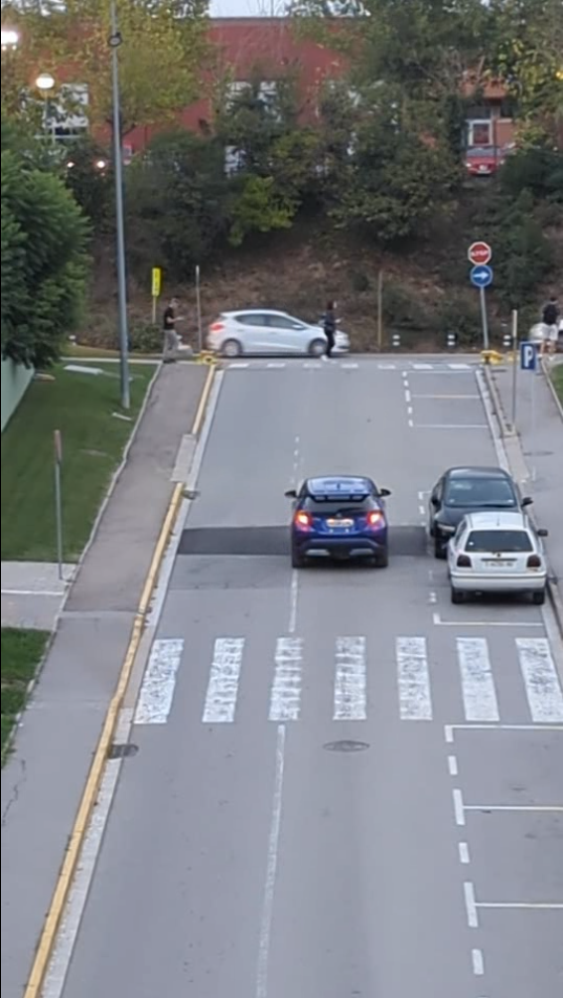
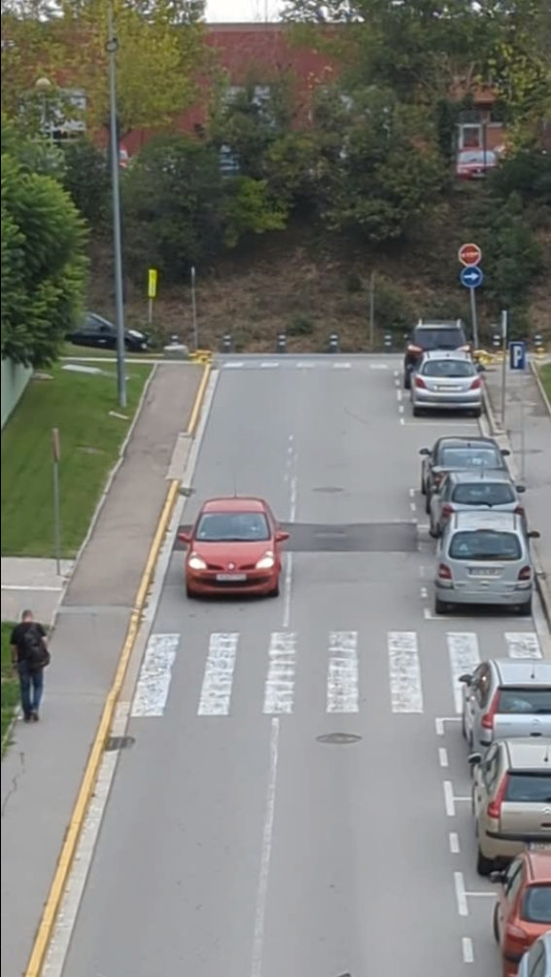
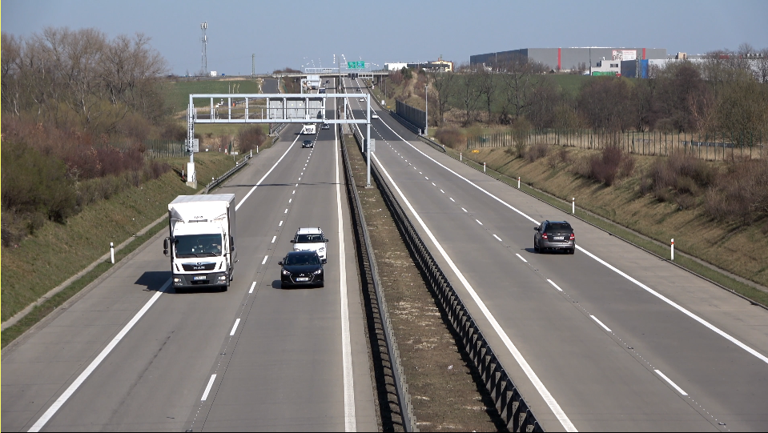
Task 1.2: Customize speed detection
Carlos Boned
1533190
Custom Sequences:
CVC SMALL: 5 min video, in the evening (less traffic)
CVC BIG: 25 min video, morning (high traffic)
EEUU HIGHWAY: 25 s video, road to measure use case
WE ASSUME CALIBRATED CAMERA
DIFFERENT PERSPECTIVES !!
Notes:
To do the speed estimation in different scenarios we collect 3 different sequences. Th first one is the CVC in the afternoon late, the second one the CVC road in the morning and we extracted a video from internet of a highway of EEUU. We used Yolo to do the tracking because it shows to be faster in the inference part, and we tried to some examples in streaming

Slide 11
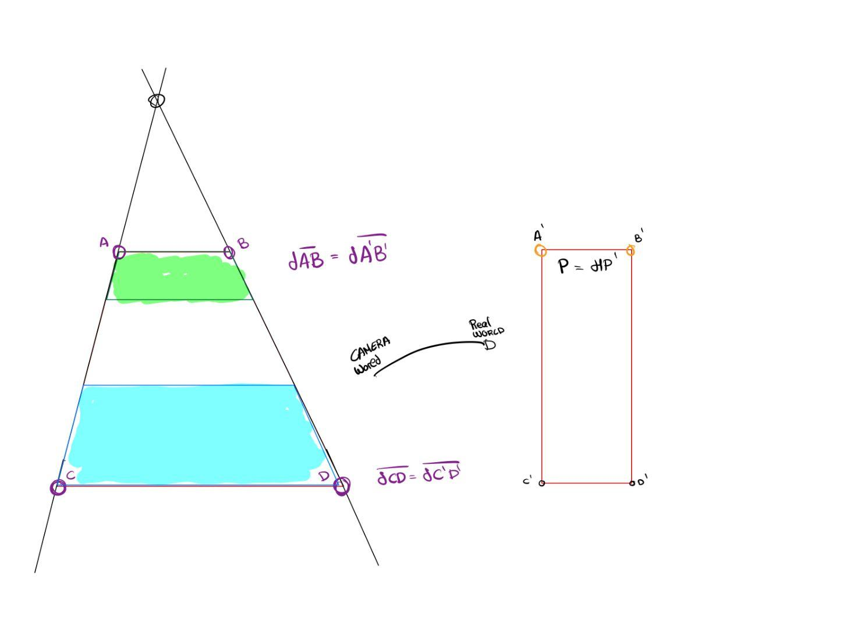
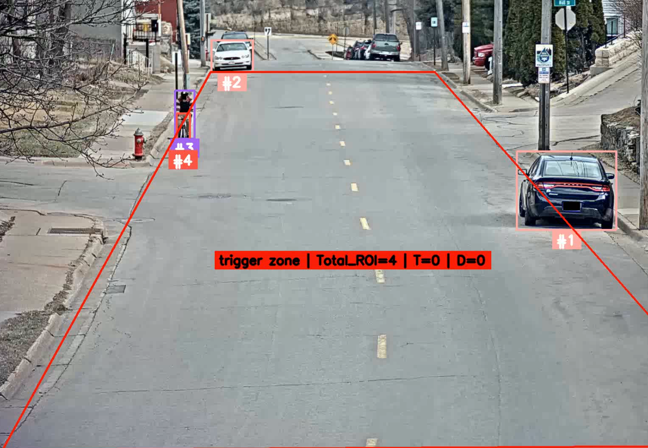
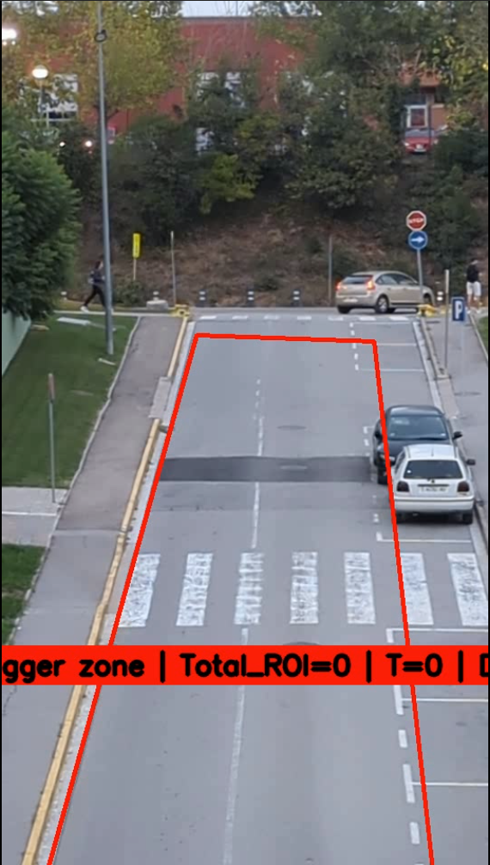
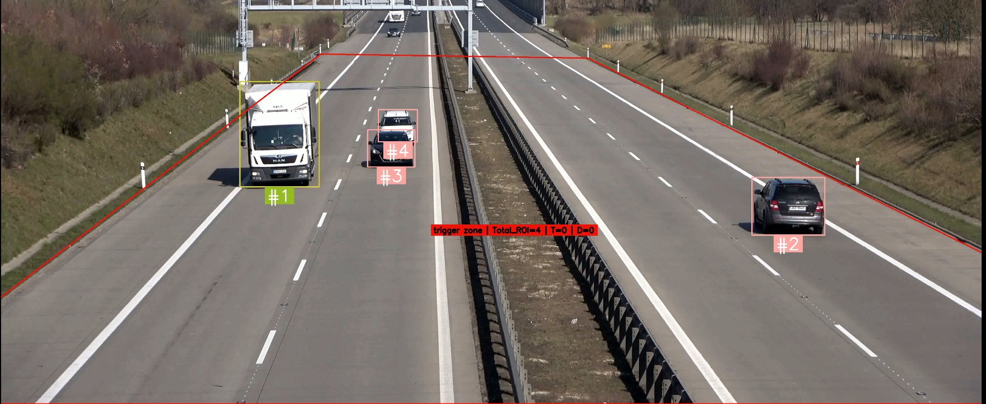
Task 1.2: Overfit Perspective Different Static Cameras
Carlos Boned
1533190
DIFFERENT PERSPECTIVES !!
DIFFERENT HOMOGRAPHY
We have cameras with some perspective distortion, parallel lines are no longer parallels in the camera world, we extract the Homography to recover the parallelism
In this case we try to simulate a traffic camera, which is static and overfitted in the place it has been put. The polygon range is computed manually and it also detects de traffic jam.
Notes:
From all the sequences, we have camera with some perspective distorsion. We assumed that all the cameras are calibrated to make the things easier. From the perspective parallel lines are no longer parallel in the camera world, so we extract the Homography to recover the parallelism.
As we want to simulate a traffic camera, which is static, we defined a trigger zone, which is the range of acting of the camera. From this trigger zone we collect all the information inside (total objects, time, etc etc )

Slide 12
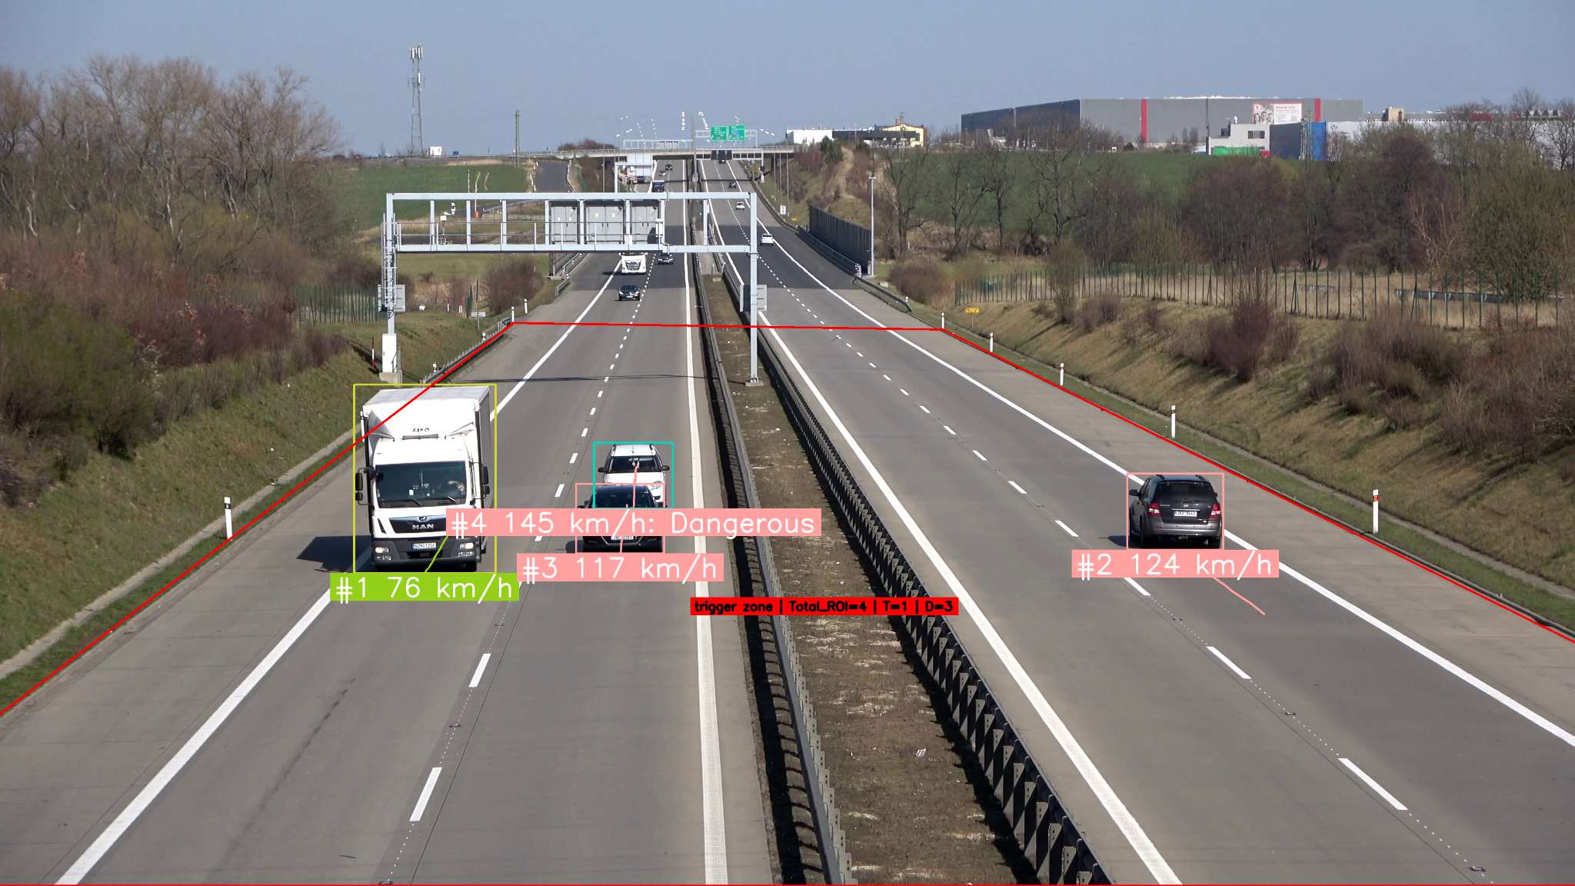
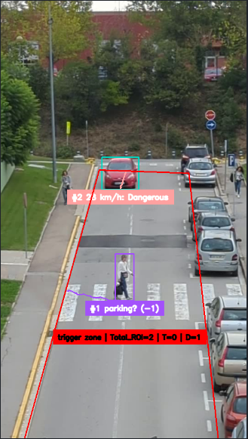

Task 1.2: Detect Dangerous Situations
Carlos Boned
1533190
It also detects situation of an exceed of velocity and there are an object to track in the trigger zone, in this case a person
As the we only care about cars, trucks etc, the label of the other objects is (-1)
We detect dangerous situations, as for example proximity or speed.
We collect the frame instance and send it to a log file with all the information belonging to that car
Notes:
We send the information to a log file to recreate, or search what happened later. In the trigger zone we also try to detect dangerous situations, which can be small distance in high velocity, high velocity with the presence of people or bikes, or the high velocity itself

Slide 13
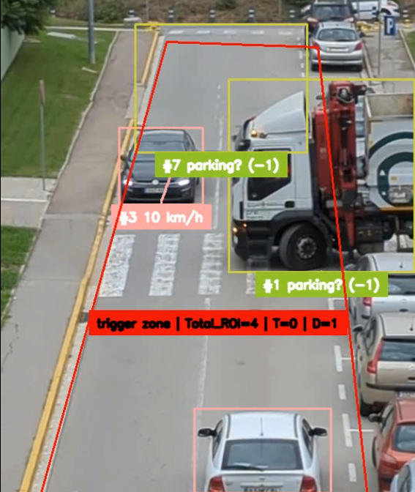
Task 1.2: Difficulties
Carlos Boned
1533190
We found some difficulties when there are occlusions, the bbox had some problems in the detection, which makes the results in the computation of the speed weird.
In this case exists an extra detection with a different track id, I didn’t figure it out why it happens.
Notes:
The problem with the different perspectives is that in some situations the algorithm do weird things. In this case the speed of the white car cannot be 30 km/h more thant the car which is in front. Other things we detect is that in the CVC sec it detects extra cars we dont know why

Slide 14
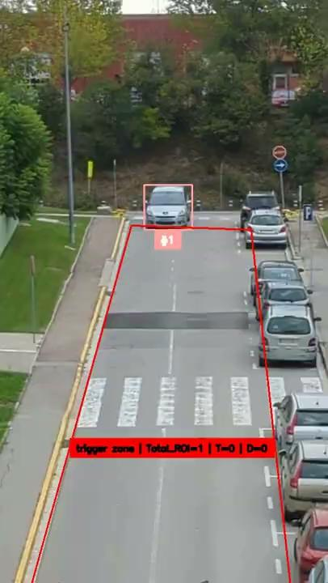
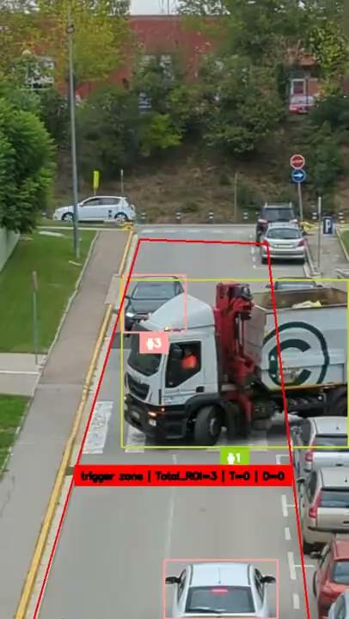
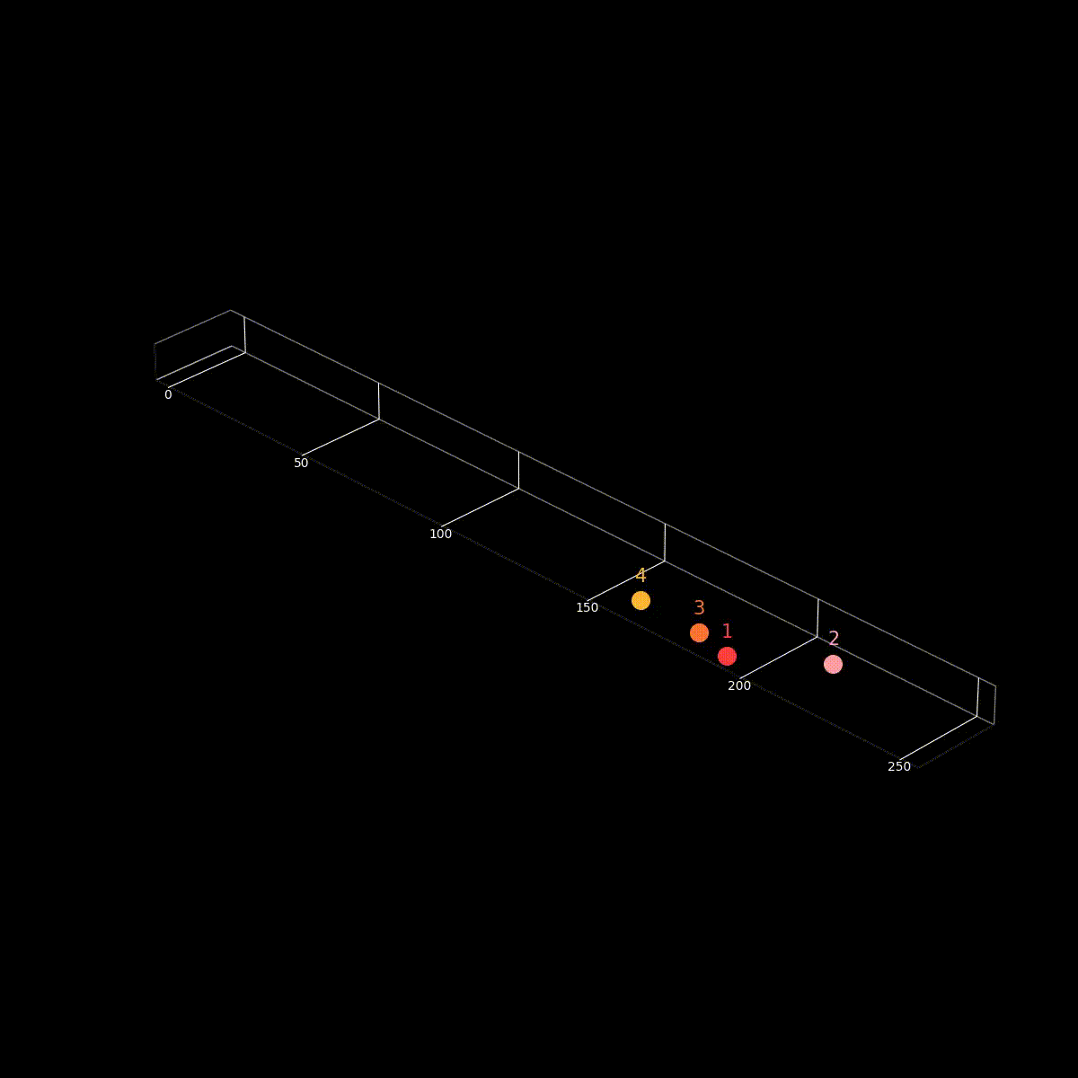
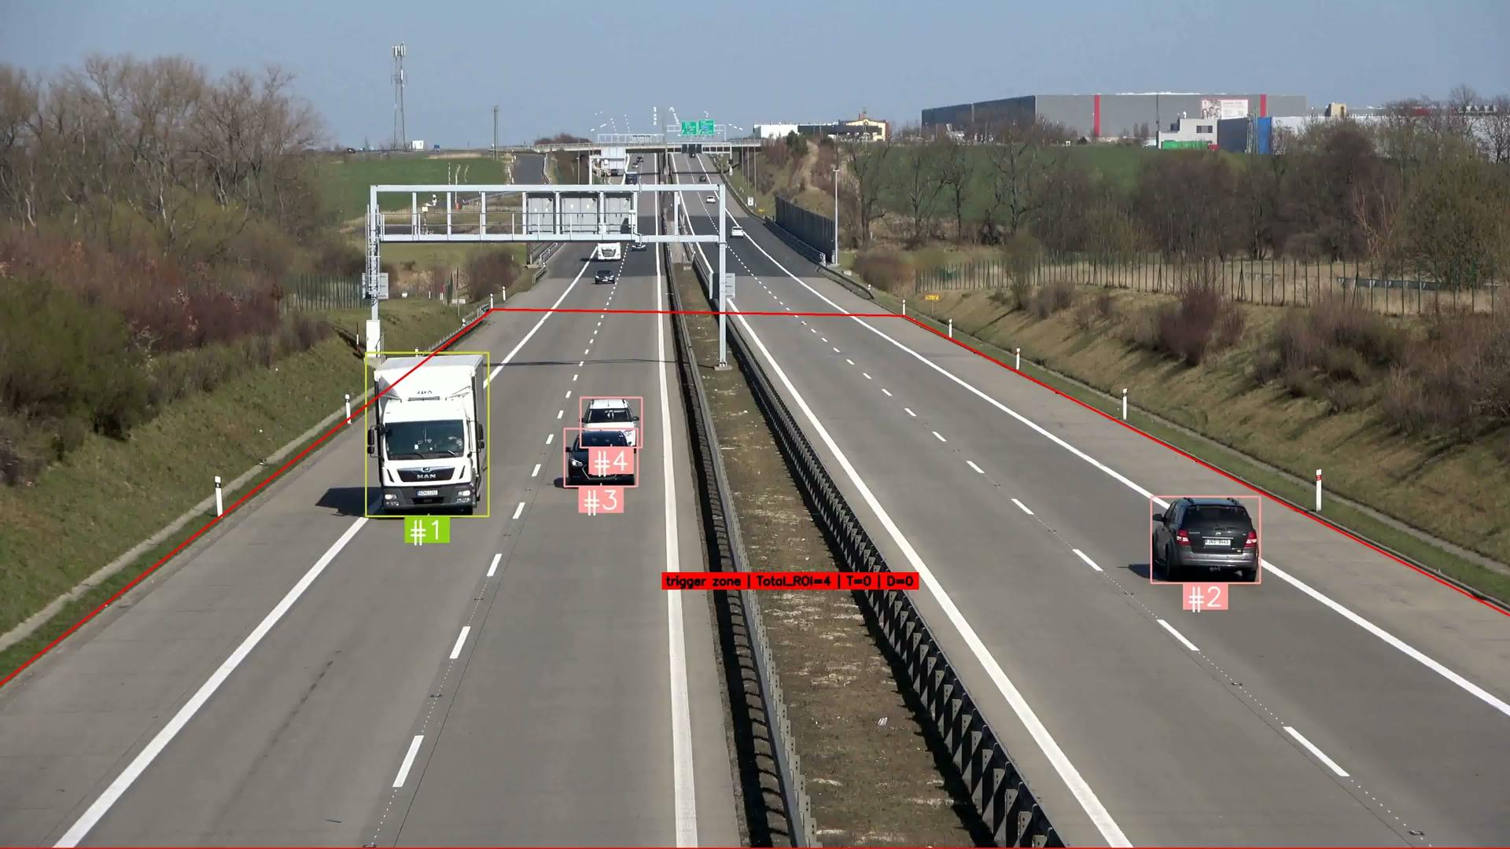
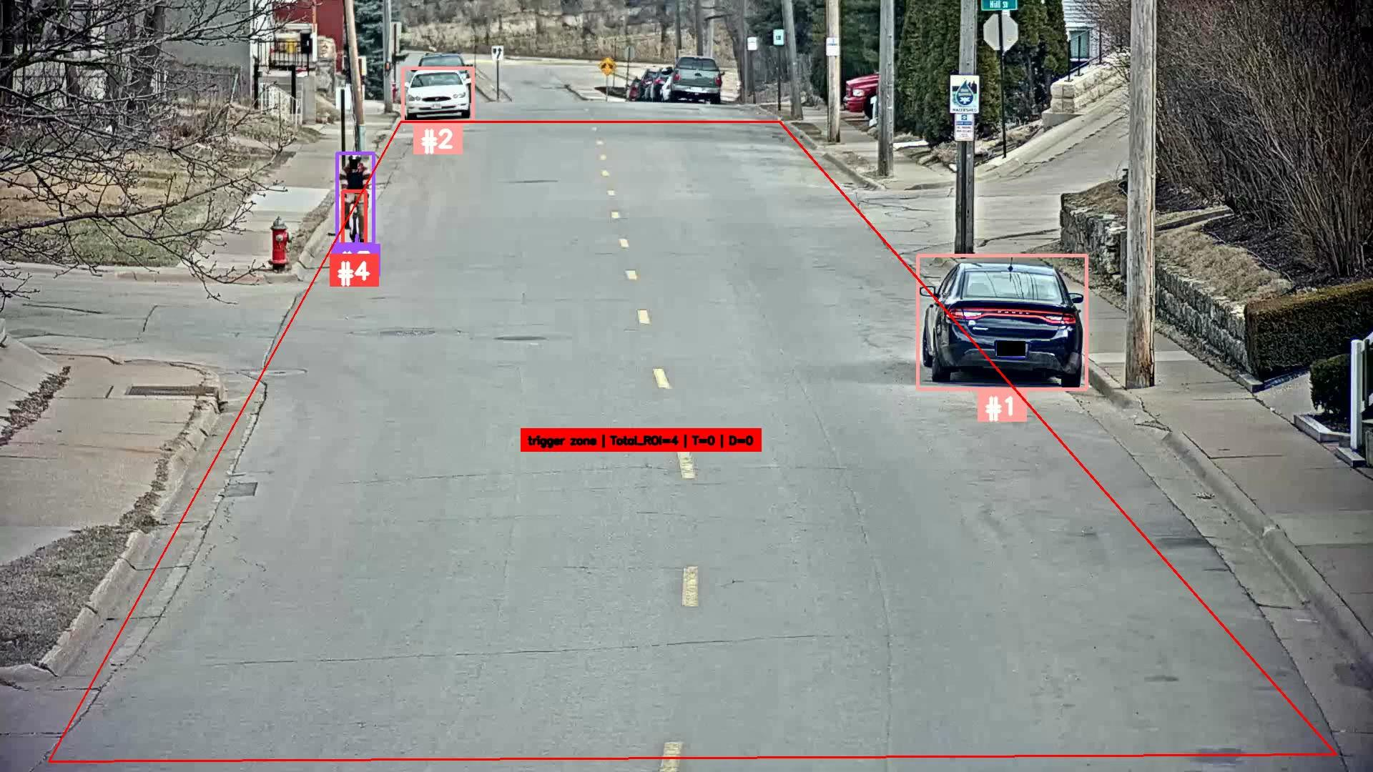
Task 1.2: Demos in different Sequences
Carlos Boned
1533190
We can recover the dangerous situations
Notes:
Finally from the logs we can collect and recreate the moments when there where something dangerous, and you have some results of out approach in different scenarios and moments.

Slide 15
Task 2:
Multi-camera tracking

Slide 16
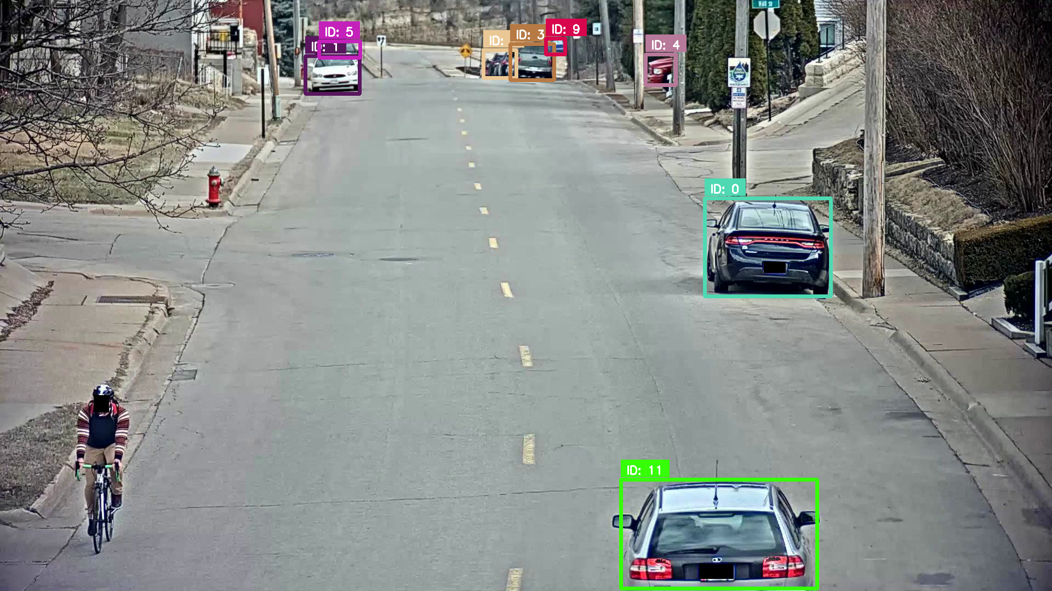
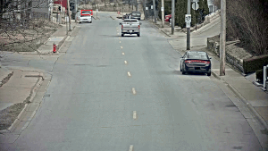
Task 2: Multi-camera tracking
MARCO CORDÓN
1691727
RESULTS FROM LAST WEEK:
IDF1 / HOTA (SEQ03)
c010 | c011 | c012 | c013 | c014 | c015 | Average
18.0/17.9 | 1.5/4.7 | 0.75/3.2 | 6.1/9.5 | 15.1/17.6 | 0.12/1.5 | 6.92/9.07
CURRENT WEEK ADDITION: Remove parked cars (Post-processing)

Slide 17
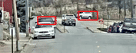
Task 2: Multi-camera tracking
MARCO CORDÓN
1691727
RESULTS FROM LAST WEEK:
IDF1 / HOTA (SEQ03)
c010 | c011 | c012 | c013 | c014 | c015 | Average
18.0/17.9 | 1.5/4.7 | 0.75/3.2 | 6.1/9.5 | 15.1/17.6 | 0.12/1.5 | 6.92/9.07
❓
CURRENT WEEK ADDITION: Remove parked cars

Slide 18
Task 2: Multi-camera tracking
MARCO CORDÓN
1691727
RESULTS FROM LAST WEEK:
IDF1 / HOTA (SEQ03)
c010 | c011 | c012 | c013 | c014 | c015 | Average
18.0/17.9 | 1.5/4.7 | 0.75/3.2 | 6.1/9.5 | 15.1/17.6 | 0.12/1.5 | 6.92/9.07
CURRENT WEEK ADDITION: Remove parked cars (Post-processing)
IDF1 / HOTA (SEQ03)
c010 | c011 | c012 | c013 | c014 | c015 | Average
57.7/36.6 | 5.33/5.82 | 9.69/11.5 | 33.4/24.0 | 52.18/38.6 | 7.42/12.04 | 27.6/21.3

Slide 19
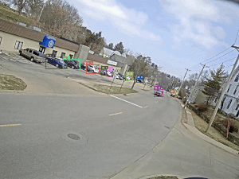
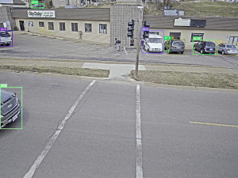
Task 2: Multi-camera tracking
MARCO CORDÓN
1691727
RESULTS FROM LAST WEEK:
IDF1 / HOTA (SEQ03)
c010 | c011 | c012 | c013 | c014 | c015 | Average
18.0/17.9 | 1.5/4.7 | 0.75/3.2 | 6.1/9.5 | 15.1/17.6 | 0.12/1.5 | 6.92/9.07
CURRENT WEEK ADDITION: Remove parked cars (Post-processing)
IDF1 / HOTA (SEQ03)
c010 | c011 | c012 | c013 | c014 | c015 | Average
57.7/36.6 | 5.33/5.82 | 9.69/11.5 | 33.4/24.0 | 52.18/38.6 | 7.42/12.04 | 27.6/21.3

Slide 20
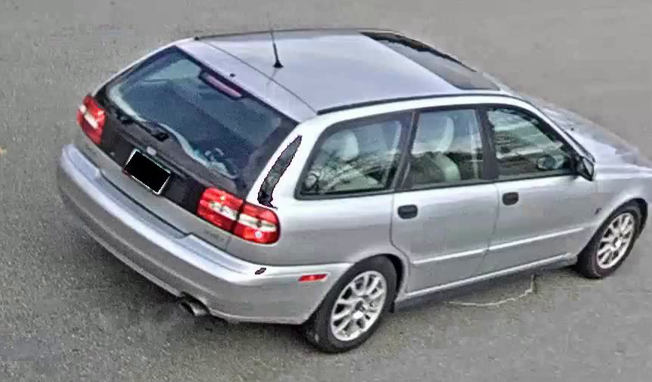
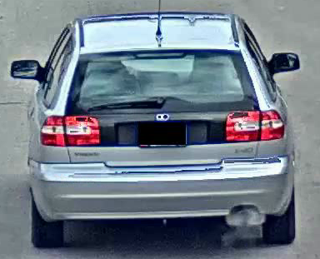

Task 2: Multi-camera tracking
MARCO CORDÓN
1691727
Proposed idea:
Use metric learning for deciding if tracks in different
cameras belong to the same car or not.
Faster-RCNN
SAME
CARS !!
Distance lower than th
Faster-RCNN

Slide 21
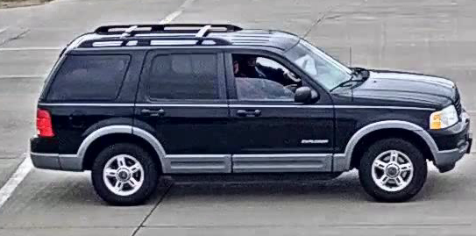
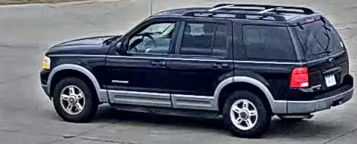
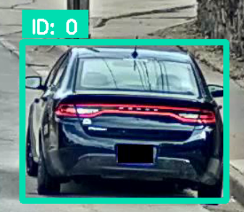
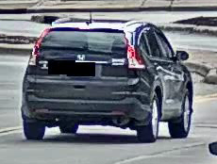
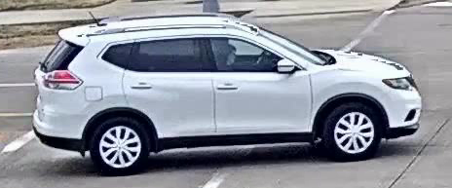
Task 2: Multi-camera tracking
MARCO CORDÓN
1691727
Model training strategy:
Use ground truth from S01 and S04
Zheng Tang, et al., “CityFlow: A City-Scale Benchmark for Multi-Target Multi-Camera Vehicle Tracking and Re-Identification” CVPR 2019.
❓
Some examples of the training instances:
Issue: Ground truth bounding box is different from Detectron2’s bounding box detection
✅
Detectron2 detection bb
Ground truth bb
⛔️

Slide 22
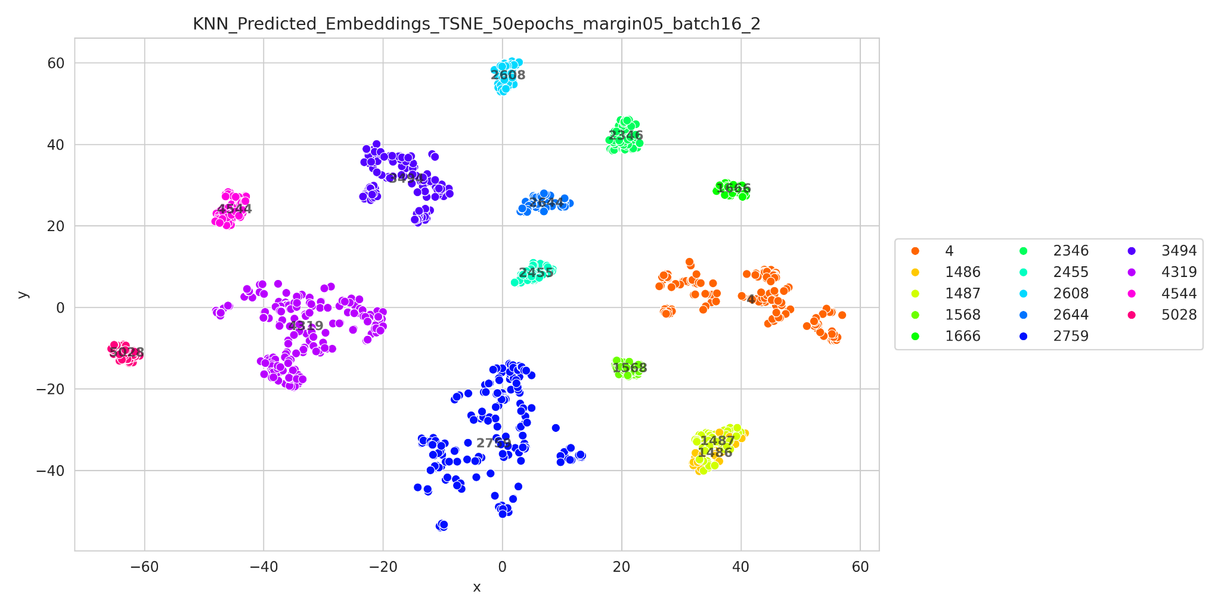
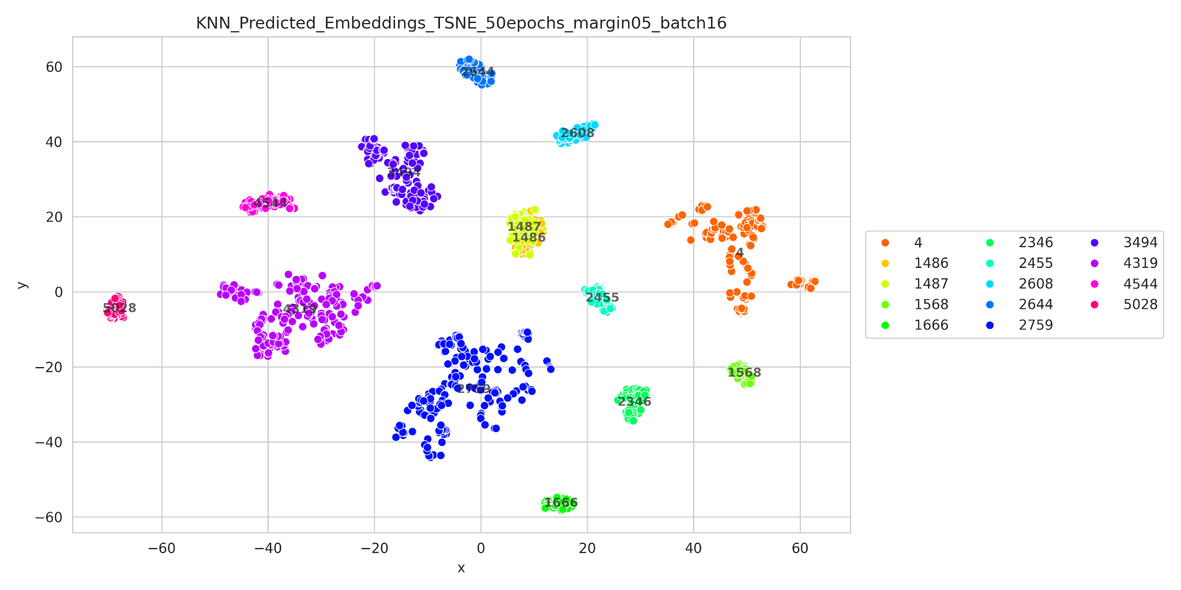
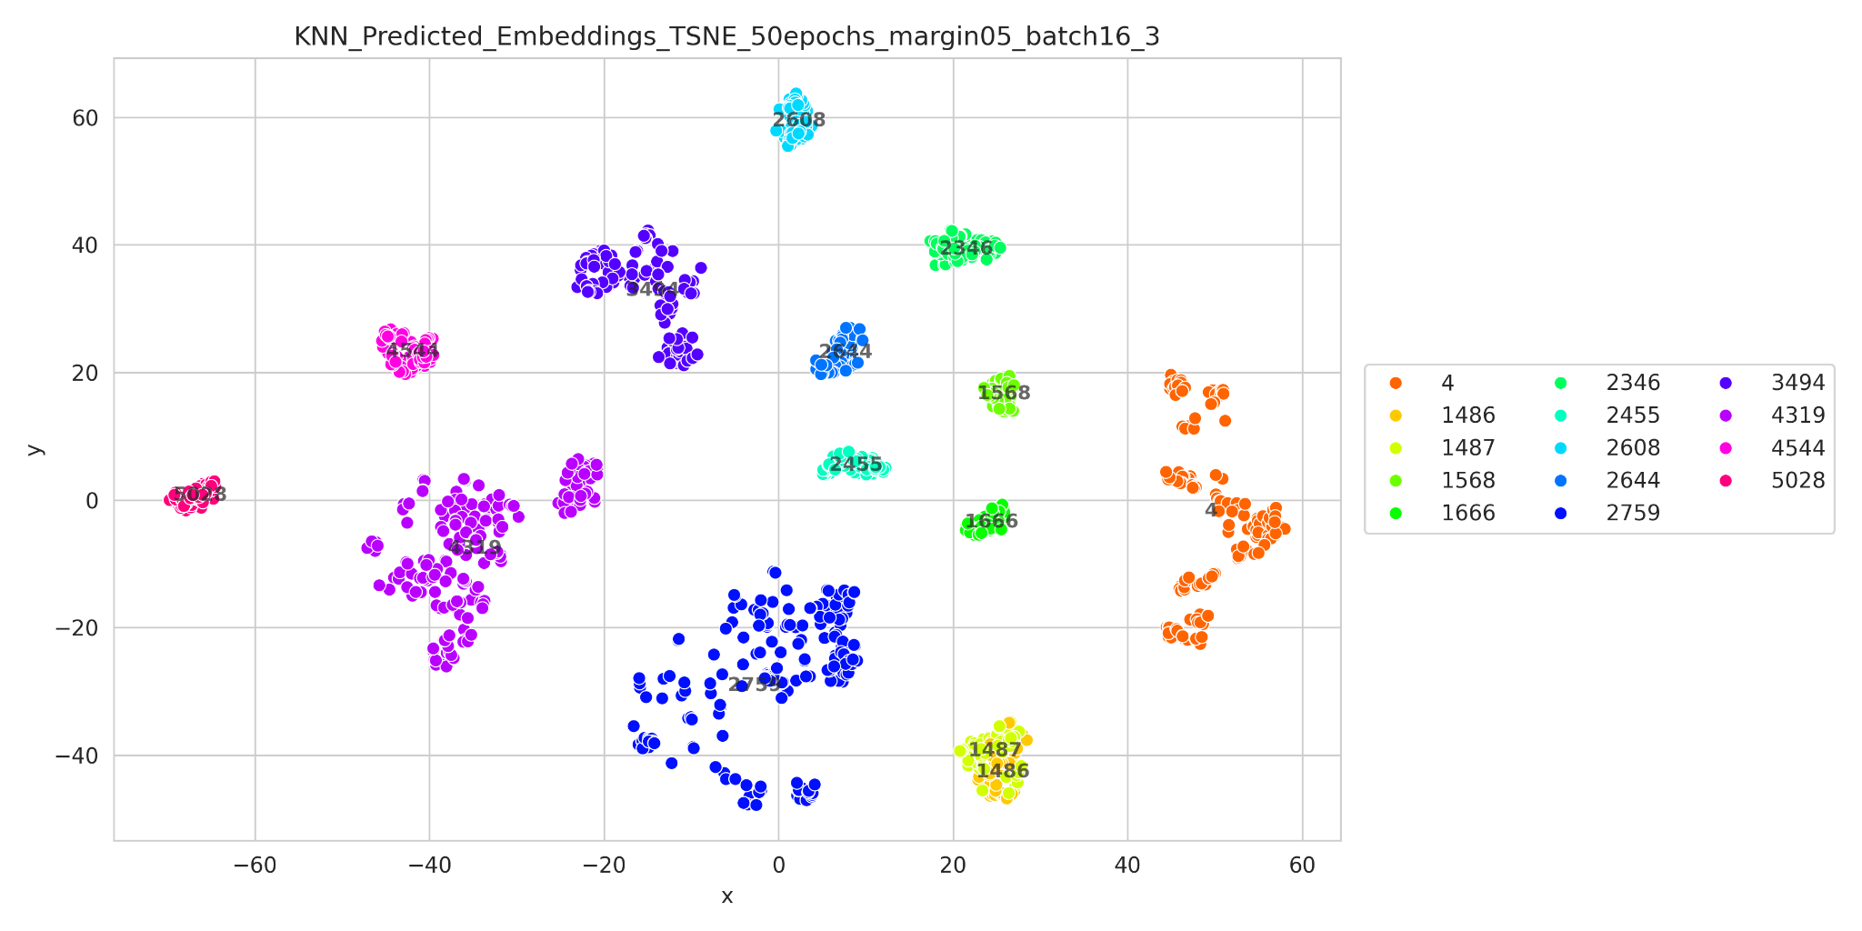
Task 2: Multi-camera tracking
IÑAKI LACUNZA
1692285
Margin 20%
Margin 10%
Margin 6,66%

Slide 23
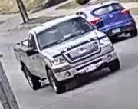
Task 2: Multi-camera tracking
IÑAKI LACUNZA
1692285
Margin 20%
Margin 10%
Margin 6,66%
Track 1487 but behind appears the 1486.

Slide 24



Task 2: Multi-camera tracking
IÑAKI LACUNZA
1692285
Margin 20%
Margin 10%
Margin 6,66%
First detections
Intermediate detections
Last detections
Track 1487 but behind appears the 1486.

Slide 25

Task 2: Multi-camera tracking
Followed pipeline:
IÑAKI LACUNZA
1692285
Chose the neighbor that is closest to most detections of the track.
Then, get the median of the distances to the chosen threshold.
Get the embeddings with the first camera and apply KNN
Next camera
Single camera tracking.
Then, get embeddings for each track.
Use the KNN model to know which are the closest.
Next camera
Same car in different cameras!!
Make their track ids the same
Median distance lower than chosen threshold?
Add the embeddings and fit again the KNN
New track, not seen yet!!
Keep its original track id

Slide 26



Task 2: Multi-camera tracking
IÑAKI LACUNZA
1692285
KNN evolution: c013 c014
Previous KNN
New KNN

Slide 27

Task 2: Multi-camera tracking
IÑAKI LACUNZA
1692285
KNN evolution: c014 c012
Previous KNN
New KNN

Slide 28

Task 2: Multi-camera tracking
IÑAKI LACUNZA
1692285
KNN evolution: c012 c011
Previous KNN
New KNN

Slide 29

Task 2: Multi-camera tracking
IÑAKI LACUNZA
1692285
KNN evolution: c011 c015
Previous KNN
New KNN

Slide 30

Task 2: Multi-camera tracking
IÑAKI LACUNZA
1692285
KNN evolution: c015 c010
Previous KNN
New KNN

Slide 31



Task 2: Multi-camera tracking
This would be a quite easy match to do, but the car in the left was not detected. Previous weeks’ weaknesses have played an important part this week.
Qualitative Results:
Misclassified, might be because they are both trucks and share similarity in their shape
Misclassification, shape and color are very similar
Quantitative Results:
IDF1/HOTA
Avg S03
27.6/21.3
Only results of S03 because S01 and S04 are employed for training so they would be false results.

Slide 32
Final Summary
Task 1.1: Rudimentary approach
Introduce horizontal axis into the mps estimation
Take advantage of existing calibration methods instead.
Task 1.2: Modern approach
We manage to apply our methods in videos with different perspectives with a decent results.
We could extend the speed estimation with the detection of dangerous situations.
Task 2: Multi-camera tracking
Due to the added preprocessing step, we were able to improve ~25% the results from last week.
At first, the implemented idea looked fine, but the final results were not the expected.
First, single-camera tracking should be improved.
For future improvements, apart from comparing tracks using the implemented threshold, other aspects such as time difference, location between cameras and speed estimation could be used.

